Slide 1
Great Bear Petroleum LLC
Diagnostic Fracture Injection Test
Shublik Shale Formation
Alcor #1
S5-T7N-R14E
North Slope Borough, Alaska
API 50223200260000
October 3, 2012

Slide 2
General Information
Shublik Shale Formation
Vertical Cemented Well
Perforations 10605 – 10620 ft
Wellbore Fluid – 9.8 lb/gal water
DFIT Fluid – 9.8 lb/gal water
BHT ~ 200°F
Net Pay ~ 40 ft

Slide 3
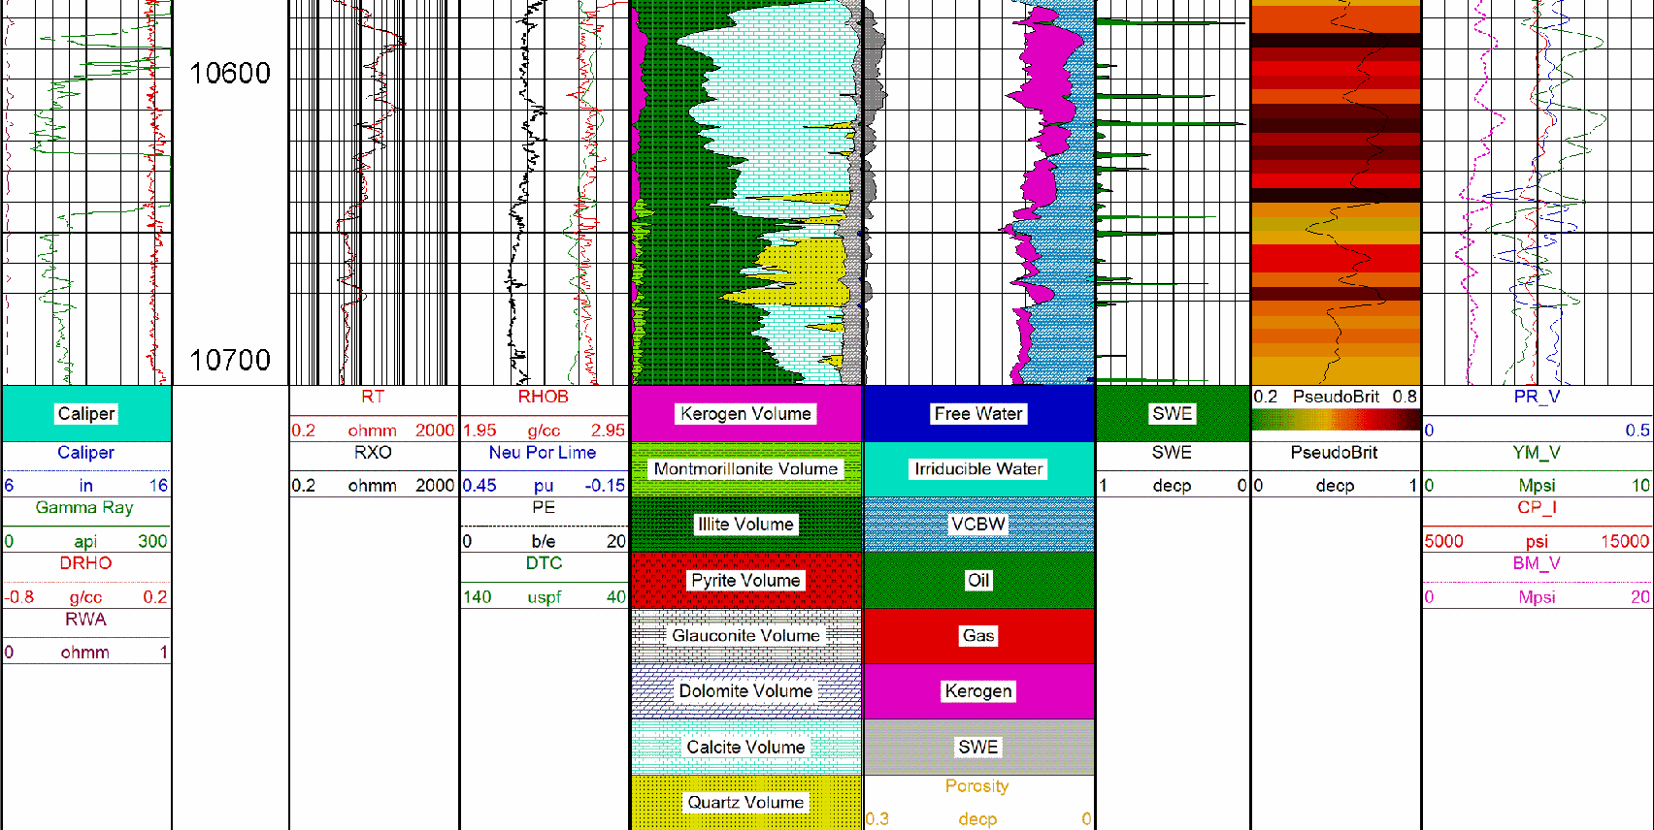
ShaleXpert
Perfs

Slide 4
Notes:
The DFIT consisted of ~5,905 gallons of 9.8 lbs/gal water injected at an average rate of 12.34 bpm. The BH_ISIP obtained was 8,517 psi which resulted in a fracture gradient of 0.80 psi/ft.
TVD used in the analysis ~ 10,610 ft

Slide 5
Notes:
According to SPE 107877, a log-log plot as shown above should be sufficient to identify closure and the various flow regimes before and after-closure. The log-log plot shows a positive ¼ slope in the semilog derivative (light blue curve) and pressure difference curves (green and red curves) in conjunction with a negative ¾ slope in the 1st derivative (dark blue) curve indicating bi-linear flow before-closure. Then closure occurs as indicated by the change in slope from positive to negative in the semilog derivative curve. Hydraulic fracture closure was estimated to be 6,857 psi which resulted in a closure gradient of 0.65 psi/ft.
Closure occurred approximately ~860 minutes (~14.33 hours) after shut-in. Slightly high process zone stress was observed. It was estimated to be ~1660 psi (0.16 psi/ft) (BH_ISIP – Closure = 8517-6857 = 1660 psi). Please note that this value is the lower limit as it can vary during fracture propagation. Please refer to SPE 107971 regarding high process zone stress.
It appears that after-closure pseudolinear flow was observed during shut-in. It is indicated by the negative ½ slope in the semilog derivative curve in conjunction with a negative 1.5 slope in the 1st derivative curve. Hence, reservoir pressure can be determined from after-closure pseudolinear flow analysis.

Slide 6
Notes:
The G-function derivative analysis plot shows pressure dependent type leakoff during shut-in. Fissure opening pressure (FOP) was determined to be ~7147 psi.
Hydraulic fracture closure was observed during shut-in and it is indicated when the superposition derivative (dark red curve) deviates downward and away from the linear trend line through the origin. It agrees with the closure observed from the log-log plot (6857 psi or 0.65 psi/ft). Closure occurred at a G-time of 20.27. The difference between FOP and closure is ~ 290 psi indicating that the stress anisotropy is probably very minimal.
Slightly High Process Zone stress was observed during shut-in (~1660 psi or 0.16 psi/ft).

Slide 7
Notes:
Since PDL is the leakoff type observed during shut-in, the magnitude of the PDL can be determined from the Leakoff coefficient plot. It was estimated to be 0.0015 1/psi. This is lower than the critical value of 0.002 1/psi.

Slide 8
Notes:
Before the Log-Log plot (SPE 107877) shown earlier was derived, this is the plot that was used to identify the various after-closure flow regimes. However, the pressure difference curve (light blue curve) shown in this plot is very much dependent upon the reservoir pressure (BUT, the derivative (red/dark blue) curve is not). By changing the reservoir pressure the pressure difference curve can be altered conveniently as well. Hence the log-log plot shown earlier (which is independent of the reservoir pressure) is predominantly used to identify the various flow regimes before and after-closure along with selecting closure.
This plot confirms that after-closure pseudolinear flow was observed during shut-in. It is indicated when the pressure difference and the derivative curves fall on a ½ slope line and is offset by a factor of 2. The two dotted lines are empirically derived start and end times for pseudolinear flow and they confirm it as well. This plot also shows that after-closure pseudoradial flow was NOT observed during shut-in.

Slide 9
Notes:
Since pseudolinear flow was observed during shut-in, the after-closure Cartesian pseudolinear flow plot can be used to determine reservoir pressure. The intercept of the extrapolated straight line through the pseudolinear flow period provides an estimation for pore pressure.
Thus, Reservoir Pressure ~ 5,316 psi (Pore Pressure Gradient ~ 0.50 psi/ft)

Slide 10
Notes:
Eventhough after-closure pseudoradial flow was NOT observed during shut-in, a qualitative assessment of the reservoir properties could be made by extrapolating the Cartesian plot of bottomhole pressure vs. Radial flow time function to the estimated reservoir pressure (SPE 60316). According to Simon et al., by assuming the “ideal” pressure decline response of an impulse injection is valid, the extrapolated slope of the Cartesian plot should be shallower than the slope obtained during actual formation pseudoradial flow. This would mean the transmissibility (and thus kh) obtained from the linear extrapolation is an “UPPER LIMIT” to the actual reservoir transmissibility (and thus kh). Hence,
Reservoir Pressure ~ 5,316 psi
Transmissibility, Kh/μυ < 1.57 md-ft/cp
Then, kh < 1.06 md-ft (Using an estimated oil viscosity of 0.678 cp @ 200 deg F and 5,316 psi)
Please note that since formation pseudoradial flow was NOT observed during shut-in, this value is an “UPPER LIMIT”. (From before closure analysis it was estimated to be 0.44 mD-ft)
The following parameters were assumed for our analysis and they need to be verified as it can change the resultant kh:
Sw=30%
GOR = 500 scf/bbl
API = 38
Bubble point pressure = 3000 psi
Porosity cutoff = 8%

Slide 11
Summary
BH-ISIP = 8,517 psi; FG = 0.80 psi/ft
Pressure dependent type leakoff was observed during shut-in.
Fissure opening pressure was estimated to be 7,147 psi.
Hydraulic fracture closure was observed during shut-in. It was estimated to be 6,857 psi. Closure Gradient = 0.65 psi/ft.
The difference between fissure opening and closure pressure is ~ 290 psi indicating that the stress anisotropy could be minimal.
PDL coefficient was estimated to be 0.0015 1/psi and this is lower than the critical value of 0.002 1/psi.

Slide 12
Summary (contd..)
Process Zone Stress observed from the DFIT was slightly high (~ 1660 psi or 0.16 psi/ft). Please refer to SPE 107971 & 123581 for information on high Process Zone Stress
After-closure pseudolinear was observed during shut-in. Thus, Pore pressure was determined from after-closure pseudolinear flow analysis. It was estimated to be P_{R} ~ 5,316 psi (0.50 psi/ft)
After-closure pseudoradial flow was NOT observed during shut-in. Hence only an UPPER LIMIT for kh could be obtained. Thus, kh < 1.06 md-ft.
From calibrated before-closure analysis permeability was estimated to be 0.011 md (Thus, kh =~ 0.011 * 40 = 0.44 md-ft).
Notes:
Please note that the following parameters were assumed for our analysis and they need to be verified as it can change the resultant kh:
Sw=30%
GOR = 500 scf/bbl
API = 38
Bubble point pressure = 3000 psi
Porosity cutoff = 8%

